Slide 1

Mormonism – and Mormons -In Extremis
Thorns Along the Covenant Path
Carrie A. Miles
Presented at 2024 Sunstone Symposium Copyright Carrie A. Miles

Slide 2
Do/did you feel uncomfortable going to church or interacting with members?

Slide 3
Examples

Slide 4
Overview
LDS religious practice is declining in part because the traditional gendered division of labor (GDL), with which it is syncretized, no longer makes sense in the modern world
As the gap between the traditional GDL and contemporary socioeconomic demands grows,
  Each succeeding generation of members experience more stress.
  Church leadership becomes more demanding and aggressive.

Slide 5
Ideas to be explained
Syncretism
Changes in the gendered division of labor
Polyvagal theory

Slide 6
Syncretism
Blending of two or more religious systems or a religious and another cultural system

Slide 7
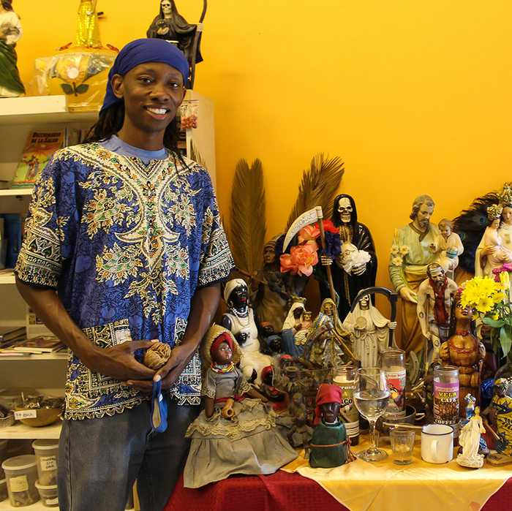
Voodoo

Slide 8
\
Gendered (or sexual) division of labor
Cultural practice of certain work being assigned by gender
I.e., “women’s work” versus “men’s work”

Slide 9
Traditional Gendered Division of Labor (GDL)
Agrarian, subsistence economies require many children as a source of labor and security
Physical limitations imposed by pregnancy resulted in the domestic specialization of women
Women become subordinate to men
Marriage customs/laws protect women in their subordinate role
“Old-fashioned” sexual morality motivates men to marry
Only two sexes and few-or-no genders
Patriarchy

Slide 10
Syncretizing patriarchy
GDL viewed as God’s will. This is particularly a problem in Mormon traditions, which teach that God is gendered

Slide 11
Massive social change in GDL since 1800
Very little/nothing is produced in modern household
The once-essential child has become an expensive luxury
Women no longer dependent on men
Marriage also becomes a luxury. Nature of marriage contract changes
Traditional sexual morality – including restrictions on same-sex relationships – becomes viewed as old-fashioned and ridiculous
Understanding of gender become fluid

Slide 12
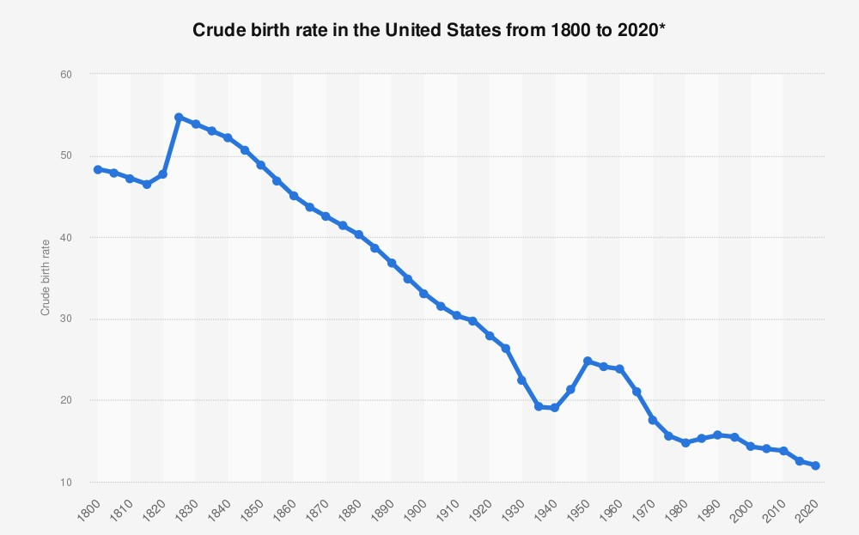
https://www.statista.com/statistics/1037156/crude-birth-rate-us-1800-2020/

Slide 13
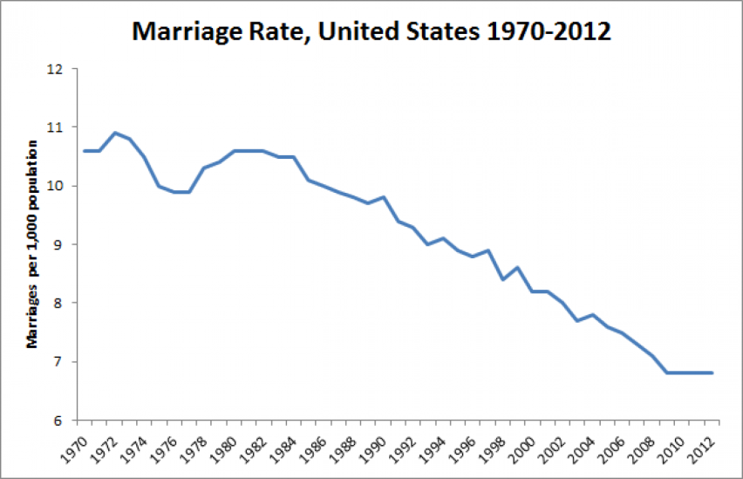
Pew Research Center

Slide 14
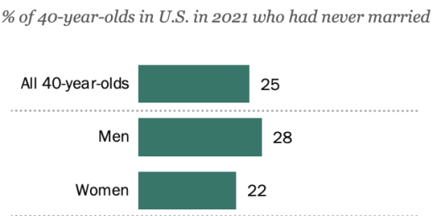
Pew Research Center 2023

Slide 15
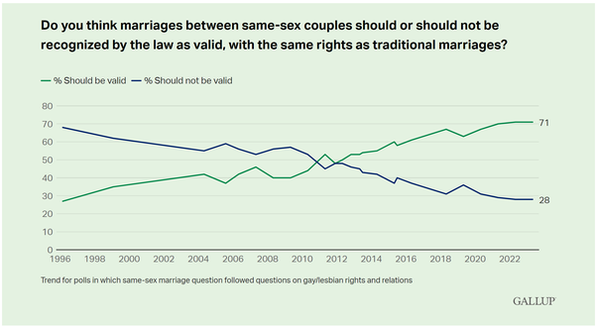
Notes:
https://news.gallup.com/poll/1651/gay-lesbian-rights.aspx

Slide 16
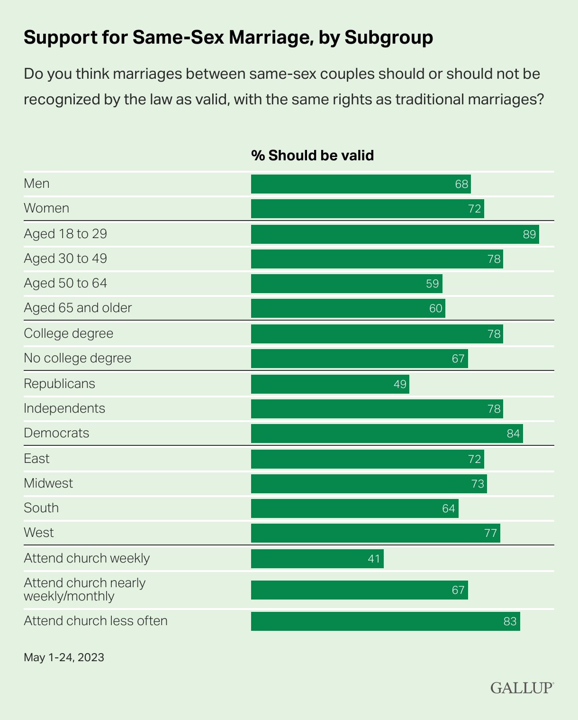
Gallup 2023

Slide 17
Percentage of U.S. Population who Identified as LGBTQ+ in 2023
Population as whole 7.6%
Generation Identified as LGBTQ+
Silent 1%
Boomers 2%
Gen X < 5%
Millennials 10%
Gen Z adults 22.3%
(Jones 2024)

Slide 18
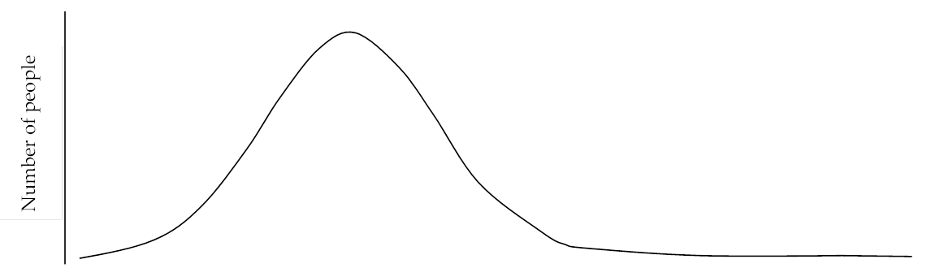
Any sexual institution
Social norms
Religious teachings
Number of people
No tension when social attitudes and religious teachings coincide

Slide 19
Sexual behavior
Sexual revolution
Traditional sexual norms
Number of people
Tension occurs when the behavior dictated by changed economic need goes in a different direction than traditional religious teachings

Slide 20
Sexual behavior
Hook- up culture
Former shared norm
Number of people
Retrenchment – purity culture
Church moves further in conservative direction while economic change continues to push behavior in the opposite

Slide 21
Little or No Middle Ground
New Norms
Traditional norms
1950s – churches stratified by class
Currently, stratified by politics (Putnam and Campbell)
Notes:
See that on both sides. Obviously, the religious right sees the differences as higher moral issues, but so do the liberal churches – schisms caused by intransigent insistence on everyone accepted new rules than by the position themselves.

Slide 22
Syncretism makes it difficult for the syncretized organization to adjust to change

Slide 23
Syncretism + Change = Growing gap between religious teachings and how people live

Slide 24
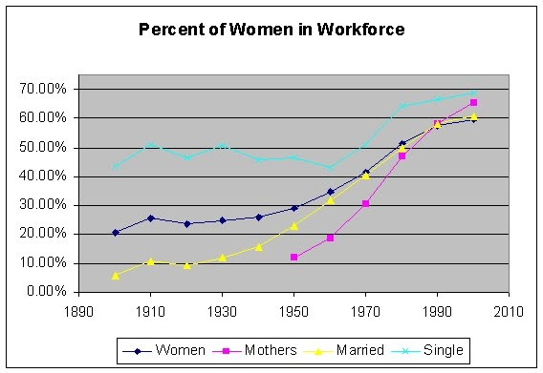
Example of the Gap
In 2019, 72.3% of mothers with children under 18 were in the U.S. workforce
What percentage of mothers with children under 18 does LDS Church teach should be in the workforce?

Slide 25
Polyvagal Theory
“The Science of Feeling Safe”
Neuroscientist Stephen Porges
All animals, including humans, constantly monitor the environment for signs of danger versus safety.
“Neuroception”: The subconscious perceptions of whether we are safe or not

Slide 26
Many Human Functions Require Neuroceptions of Safety
Sleep
Breastfeed
Care for children
Higher cognitive functions, including creativity
Spirituality

Slide 27

Neuroceptions of Danger
Notes:
Ask them

Slide 28
Danger
When danger is detected, the body automatically goes into fight, flight, freeze, or fawn mode

Slide 29
Impact of Purity Culture – Former Members
The therapist helped me see that my worthiness interviews with Mormon bishops were abusive, particularly the interviews where I had to go into detail about my private sexual life and give a play-by-play. At the time, I remember feeling proud that I confessed but also felt so hurt and exposed because of all the detail I was asked to share. And I remember being very uncomfortable whenever I ran into the bishop later: there was a secret he knew about me that was shameful.
I had the least invasive variety (do you watch porn? Often? Do you masturbate? Alright, just don't do it again) and the deep shame from having to tell a middle-aged man I barely know about things that are frankly not his or anyone else's business still affects me. They are inherently abusive.
15 years later and I'm just now finding my voice when talking to middle aged men...
Notes:
Evidence that the gap makes people feel unsafe

Slide 30
Impact of Emphasis on Marriage
Percentage of LDS in Next Mormons Survey who believe “wholeheartedly in all” LDS teachings
Married 54%
Single 38%
Reiss 2019

Slide 31
Impact of Emphasis on Marriage
          Currently Married Never Married
Currently Mormon 65% 18%
Former Mormon 46% 25%
“Many Mormon singles feel judged or shamed, or express frustration that the church seems to be worshiping the nuclear family instead of Christ.”
“…single women can experience a crisis of identity in the church because of its constant emphasis on motherhood.”
One single Mormon woman, recognizing that she would not marry, realized that “she could not stay in the LDS Church and also hold on to her sense of self-worth.”
Single men viewed as dangerous.
            Reiss 2019

Slide 32
Emphasis on Stay-at-Home Motherhood: “Mothers Come Home”
Originally the talk was given by LDS Apostle Spencer W. Kimball in 1963 quoting a judge calling for mothers to leave the workforce.
Elaborated on in 1977 when Kimball was president of the Church.
As president of the Church, Ezra T. Benson quoted liberally from this talk in 1987.

Slide 33
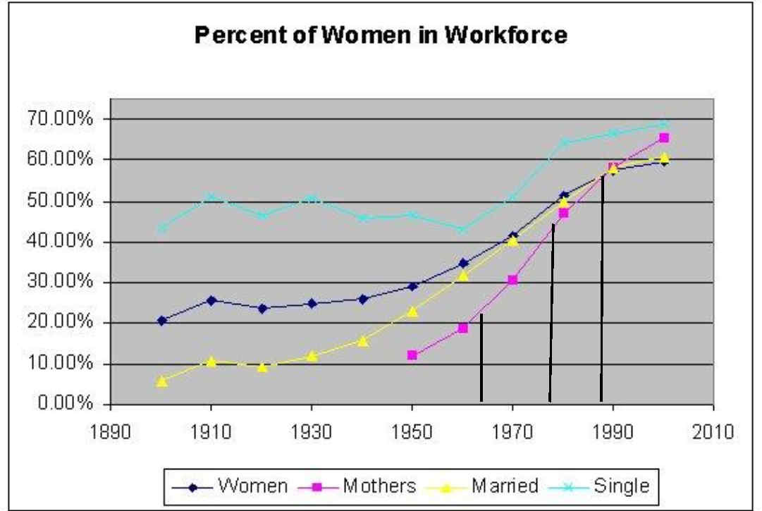
In 2019, 72.3% of mothers with children under 18 were in the U.S. workforce

Slide 34
“Mothers, Come Home”
Percentage of U.S. mothers in workforce
1963 – about 21%
1977 – about 45%
1987 – about 65%
2019 – 72.3%
“Before, I would cry every time I’d hear a Church leader say I should be home with my children. ….[W]hen President Ezra Taft Benson…told mothers to stay home, I felt so guilty and miserable that all I could do was cry.” (Rodriquez 1988).

Slide 35
As the gap between the socioeconomy and the syncretized position widens, each succeeding generation in patriarchal churches will be more and more stressed

Slide 36
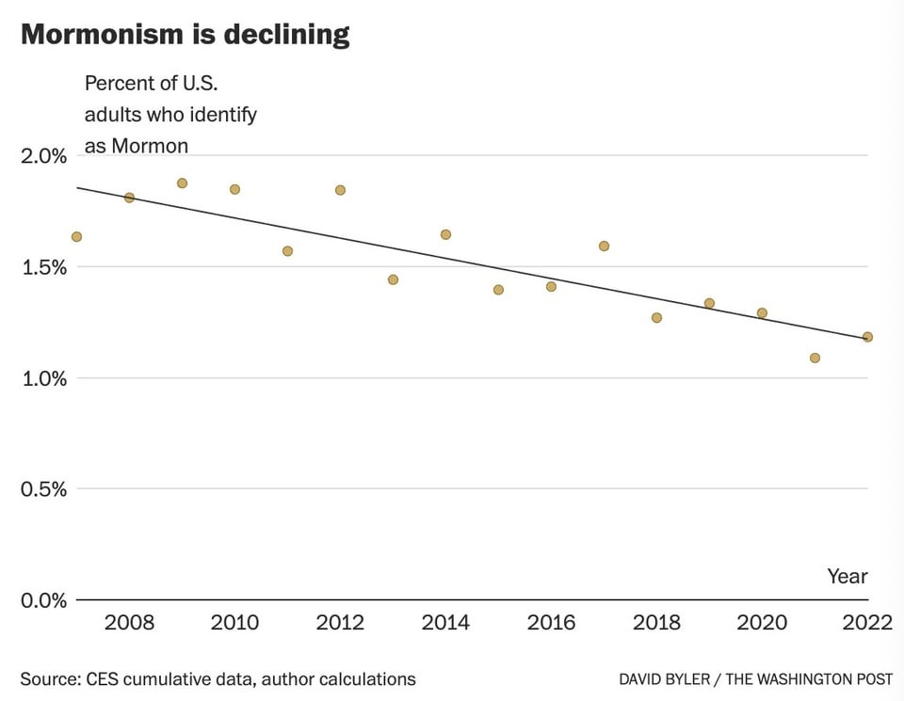
1.2
2022 survey found that 1.17% of respondents identify as LDS

Slide 37
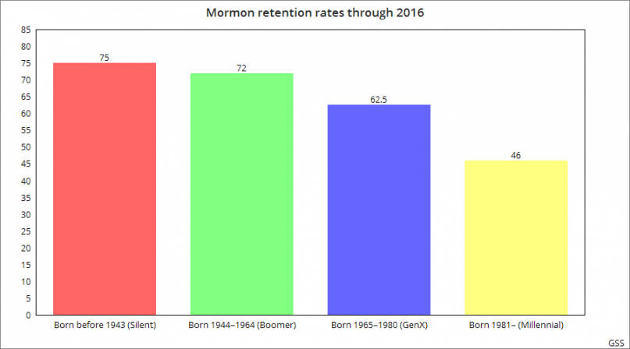
Retention Rate by Age Cohort
Church of Jesus Christ of Latter-day Saints
Reiss 2019, GSS data

Slide 38
Reasons for Leaving the Church
For Millennials
“Felt judged or misunderstood” was #1 reason, tied with “Did not trust the church leadership” (Indicators of not feeling safe)
LGBT issues is #3
Role of women in the church is #10
For GenX,
“Felt judged or misunderstood” is #3
LGBT issues is 6th reason for leaving
Role of women in the church is #8
For Boomers/Silent generation,
“Felt judged or misunderstood” is #7
Neither LGBT nor women’s issues are in the top ten
Reiss 2019

Slide 39
  Respond to threat by getting “big and loud”
  Examples?
Survival-oriented Institutions
Notes:
Hoarding money. Pushing back on changes. Pushing back on bad PR. Emphasis on the family. Temple building

Slide 40
Public relations are fraught
Criticism or bad PR is threatening -- Responds to criticism with anger
The Church has protected sexual abusers, not the victims, because by speaking up, it is the victims that endanger the Church
Church statement in response to outcry over child sexual abuse case in Arizona:
“The church has issued a strong response because this is a topic where there can be no mincing of words, no hint of apathy and no tolerance for
Notes:
Finish the sentence. “Regarding child sexual abuse, the Church has not tolerance for….”

Slide 41
Public relations are fraught
Criticism or bad PR is threatening -- Responds to criticism with anger
The Church has protected sexual abusers, not the victims, because by speaking up, it is the victims that endanger the Church
Church statement in response to outcry over child sexual abuse case in Arizona:
“The church has issued a strong response because this is a topic where there can be no mincing of words, no hint of apathy and no tolerance for any suggestion that we are neglectful or not doing enough on the issue of child abuse.”
Notes:
Finish the sentence. “Regarding child sexual abuse, the Church has not tolerance for….”

Slide 42
Syncretism = Difficulty Adapting
LDS teachings on “families are forever” fall exactly on the syncretized stress point.
Church cannot accommodate social change because its teachings on sexual institutions are the only tool of control it has left.

Slide 43

Emergent Strategy to Maintain Control:
“Stay on the ‘Covenant Path’”/
“Think Celestial”/ Emphasis on temples
“Staying on the Covenant Path” essentially means to live in conformity to Church authority
Notes:
That seems fairly benign. How is this aggressive?

Slide 44
From Enticing to Threatening
Teachings on “eternal families” and the motto, “Families are forever” were once used to attract and assure members (i.e., signals of safety.)
Statements made about family in October 2023 General Conference:
are more threatening than promising
enlists faithful family members to police the less-faithful
blame members if family members leave

Slide 45
Summary – The Family Per October 2023 GC
Even if active members, if parents are not completely compliant, they will lose their children (Godoy)
Heterosexual temple marriage is necessary for exaltation (Oaks) (but not sufficient, as…)
Exaltation also requires sealing connections to all ancestors and descendants (even if you do not want to be sealed to toxic family) (Christofferson)
Those who are not compliant are choosing not to be with families and will be given “telestial” (sexless?) bodies in eternity (Nelson)
Non-believers are dangerous/heeding devils. Members must not “take counsel” from them (Nelson)

Slide 46
Church’s self-defensive responses exacerbates members’ neuroceptions of danger

Slide 47
Impact on Individuals
Examples?
Notes:
Chronic anxiety. Depression. Agitation. Perfectionism. Never good enough. CPTSD. Poor boundaries

Slide 48
Impact on Individuals
Chronic anxiety
Depression
Agitation
Perfectionism
Feeling of never being good enough
C-PTSD
Notes:
Chronic anxiety. Depression. Agitation. Perfectionism. Never good enough, CPTSD

Slide 49
Neurological Responses to Feeling Unsafe
Fawn
Flight
Fight
Freeze

Slide 50
Fawn
“To to act servilely; cringe and flatter.”
Individual has learned that protesting, fighting, or fleeing judgment just leads to more abuse.
Perfectionism/Scrupulosity – Attempt to relieve anxiety through religious means/obsessions.
Say “yes” to all requests.

Slide 51
Flee
Disaffiliation from Church
Alienation from Family
“Escapism”
Substance Abuse
Notes:
Video games, social media,

Slide 52
Fight
Individuals may openly protest Church authority
or
Take the Church’s side and combat those who oppose it
Political radicalization
Covert aggression
Relive stress by striking out at unrelated partners
Notes:
Ask for examples of how people protest Church authority.

Slide 53
Fight – With Syncretized Patriarchy, different for men than for women
Syncretization of patriarchy = culturally-mandated narcissism, with strong beliefs in male entitlement.
“Impotent entitlement” – when people believe they are entitled/obliged to have something .
But the things to which they are entitled are also obligations, and if they fail to achieve them, they are failures.
Fall into patterns of violence and despair.
Vulnerable to addictions and conspiracy theories
Notes:
Ask for examples of how people protest Church authority.

Slide 54
Freeze
Depression
  “Antidepressant drugs are prescribed in Utah more often than in any other state, at a rate nearly twice the national average.”

Slide 55
Impact of Long-term Exposure to Danger
Chronic Post Traumatic Stress Disorder
Active trauma
Not just a “psychological” problem, but also damages the body
Become aware of feelings of danger and their causes
Eliminate causes
Trauma-informed therapy

